Slide 1
Transfer LEarning
Keith Burghardt, Kristina Lerman
USC Information Sciences Institute
DSCI 552 – Spring 2021

Slide 2
Outline
Motivation
Fairness as a data shift problem
Protected groups have different feature distributions
Models are not well-adapted outside of the distribution they are trained on
Transfer learning as a solution
Types of transfer learning

Slide 3
Motivation
Learning to walk before you can run
Clearly some things we learn from walking can be applied to running
Similarly, AI can apply findings from one task (for example with a lot of training data)…
To another (with less training data)
Alternatively, there may be many related tasks, each with little data, but a model well adapted for each task can be a better model overall
Let’s provide a case-study…

Slide 4
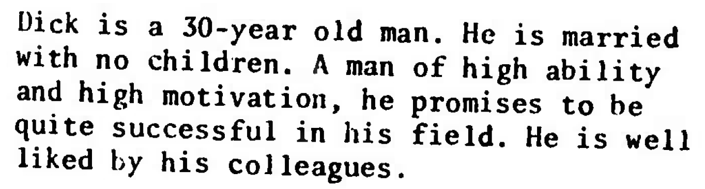
Who am I to judge?
People make poor decisions, can AI do better?
Subjects evaluated 100 people: are they a lawyer or engineer?
70/30 lawyers to engineers in group A, 30/70 in group B
Subjects labeled 1/2 of people “lawyer” in both groups
They used stereotypes rather than predictive features
Tversky and Kahneman, 1973

Slide 5
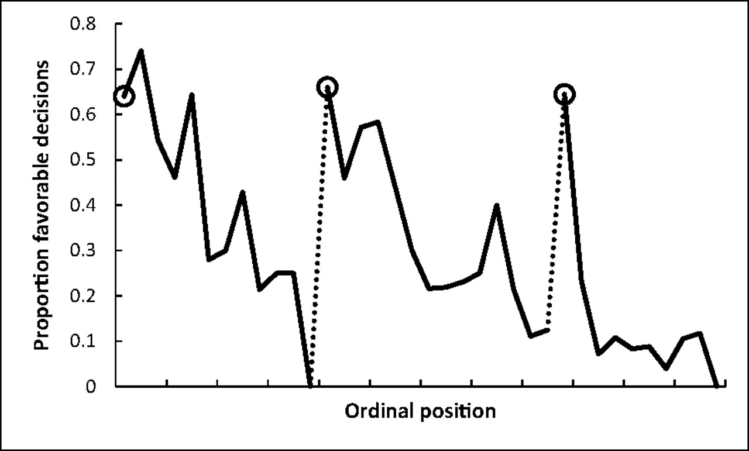
Case Study: Breaks Change Judge Decisions
How to judge guilt?
Human judgements are biased
Decisions affected by
Cognitive depletion
Social influence
Primacy
…

Slide 6
Benefits of AI
Explores what features predict outcome (e.g., lawyer vs engineer)
No explicit biases, racism
Works at global scale, no cognitive depletion
Algorithms are reproducible
Mistakes can be caught
Code acts as clear thought process (unlike human mind)
Neural networks can be exception

Slide 7
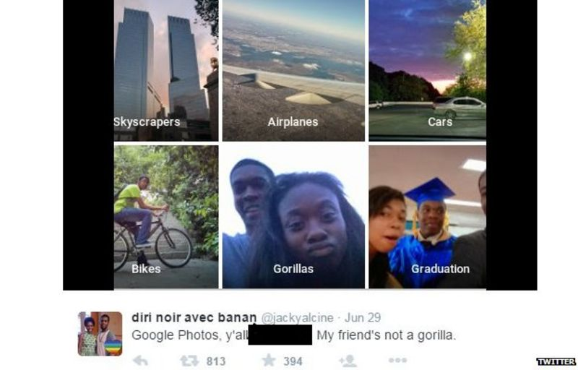
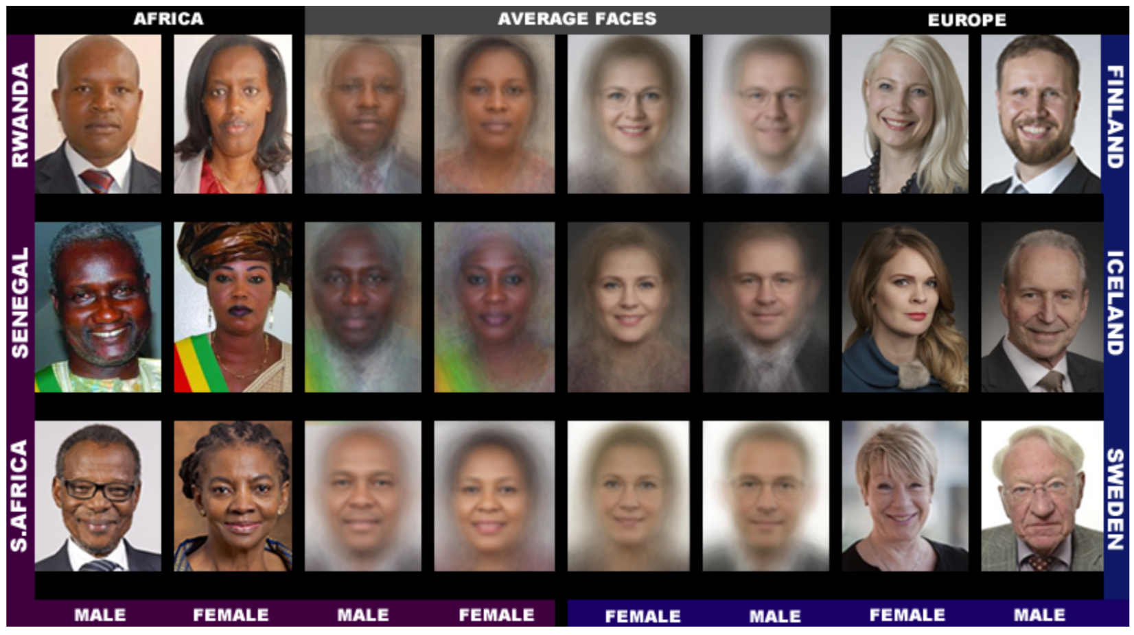
Models are poorly trained on minorities
Normal baseline images are ~80% white
Models were likely trained on mostly white images
Diverse data baseline reveals poor performance
Buolamwini and Gebru, 2018

Slide 8
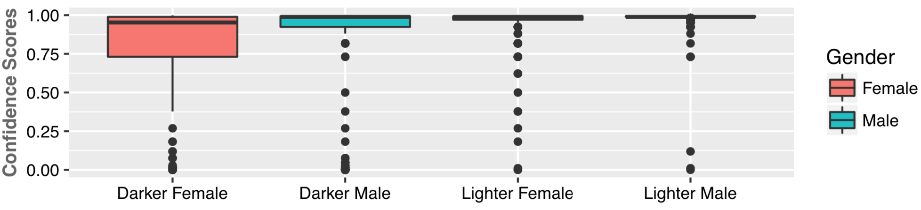
AI Fairness and Gender
Determining gender is not a solved problem
Commercial algorithms perform poorly on:
Women
Darker-skinned individuals
Buolamwini and Gebru, 2018

Slide 9
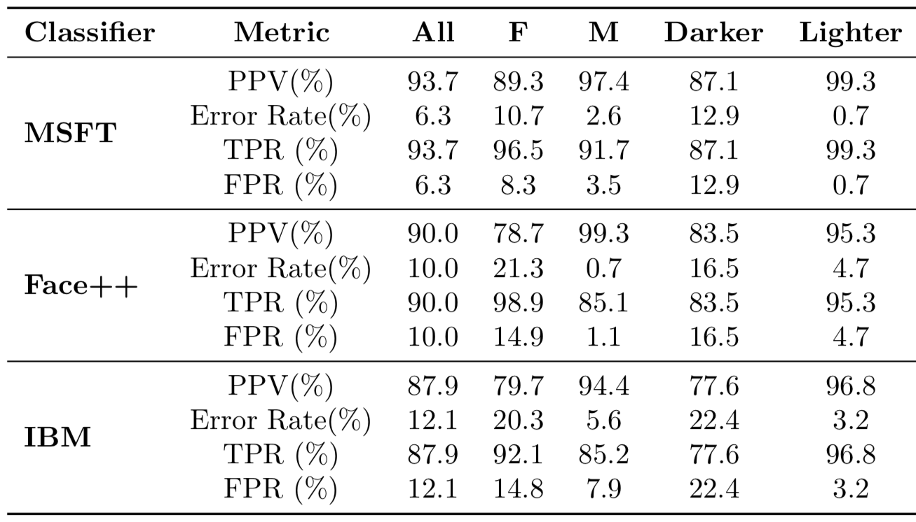
Poor data = poor predictions
Female Gender Misclassified More

Slide 10
Improving Fairness: Invariance
Pre-processing:
Remove biases from features
Examples:
Fair PCA
Linear feature debiasing
Model:
Fairer classification & regression (e.g., adversarial, regularization,…)
“Price of fairness”: we cannot have an optimal model that is fair
Post-processing:
Remove biases from model predictions
E.g., debiased graph or word embedding
Invariance is a common (maybe the most common) method for AI fairness*
*c.f., Mehrabi et al.,
A Survey on Bias and Fairness in Machine Learning. 2019

Slide 11
Some Features May be Similar Across Races, Others Different
Naïve Solution (Solution 1): 1 model fits all
Problem: Difficulties in making predictions across races demonstrates that the feature distribution or correlations change across protected groups
Therefore, this fails at making adequate predictions for all groups
Solution 2: Create models unique to each group
Problem 1: Some groups have relatively little data
Problem 2: Relatedly, this solution ignores similarities in models across groups
Solution 3: Transfer learning
Take advantage of similarities across protected groups
But specialize models within protected groups to address unique features/data distributions

Slide 12
General Reasons for TL
Data shift
Data is different between training and testing
New scenarios
Apply pre-trained high-quality model used to detect clothes
Apply to data poor domains
How to translate with little data of target language
…

Slide 13
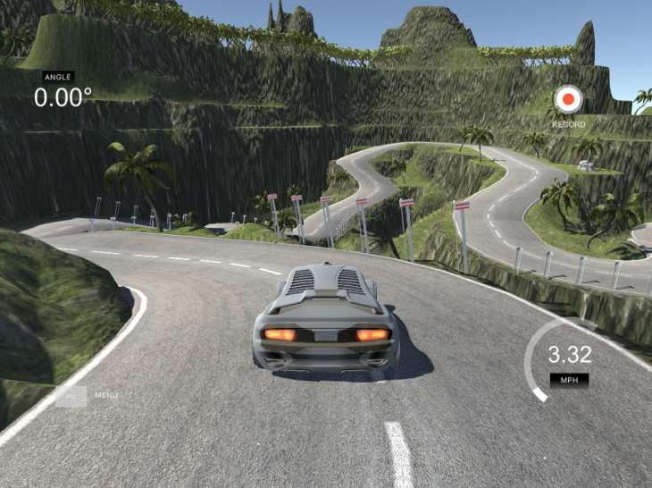
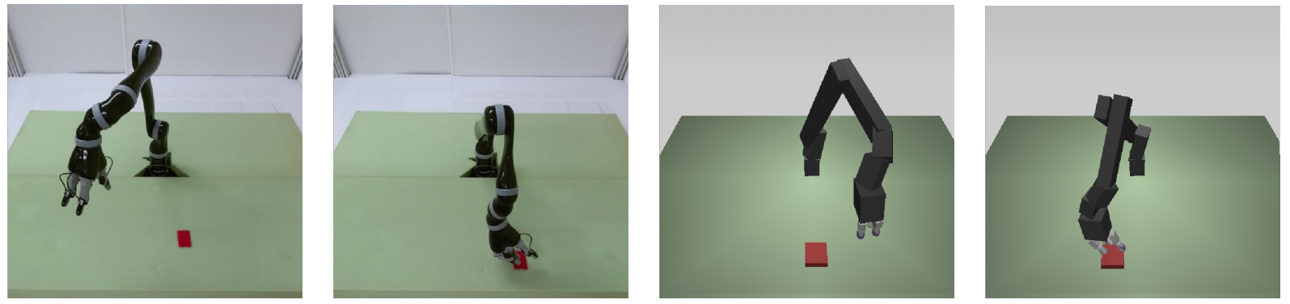
Example of Domain Adaptation: Simulations
Learning from simulations
E.g., self driving cars
More generally seen in robotics
More data, precisely controlled environments, and simulations can go at computer speed (fast!)
https://ruder.io/transfer-learning/index.html
https://tcrn.ch/3uYRynx

Slide 14
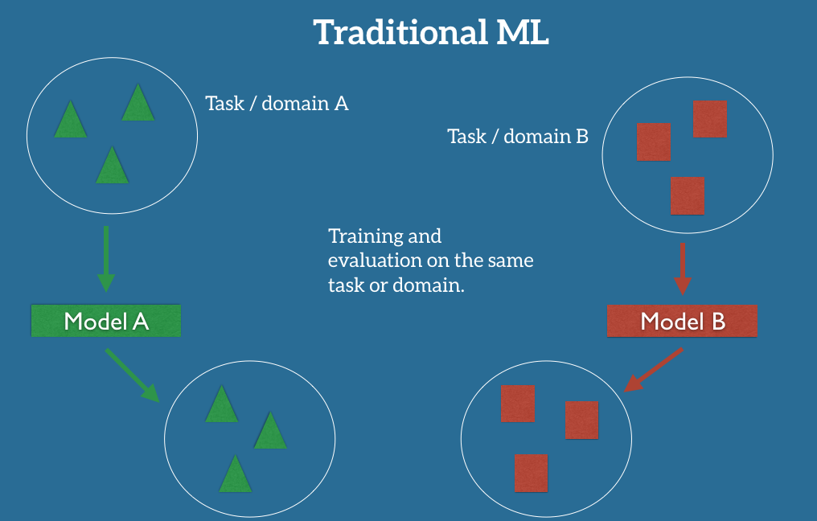
How Does Transfer Learning Work?
https://ruder.io/transfer-learning/index.html

Slide 15
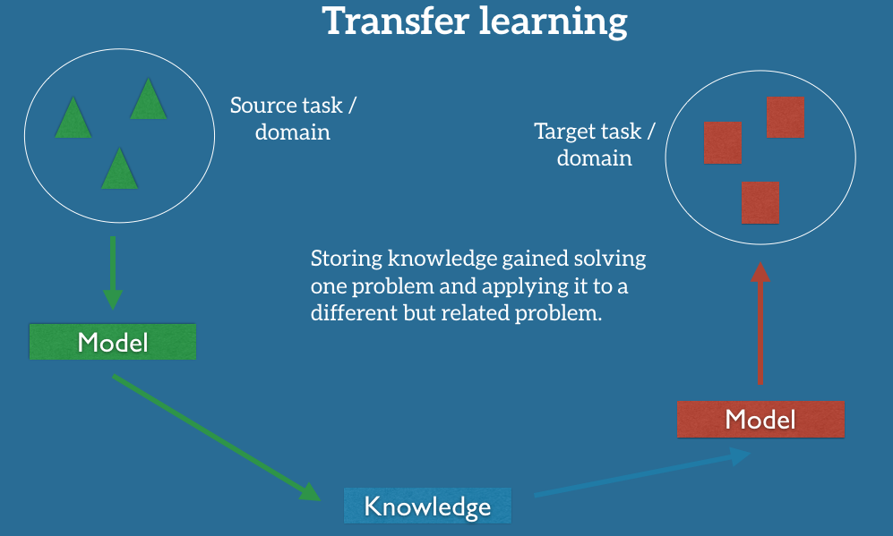
https://ruder.io/transfer-learning/index.html

Slide 16
Types of Transfer Learning Problems
Features in the source and target data are different
E.g., detecting stress from heart rate features vs social media posts
Feature distributions are different
Known as “domain adaptation”
E.g., images of GTA 5 vs real images of streets
Distribution of labels differ
Credit ratings for one dataset versus another
A large dataset could be from a wealthy neighborhood or country
…while a smaller dataset could be from a poorer neighborhood or country

Slide 17
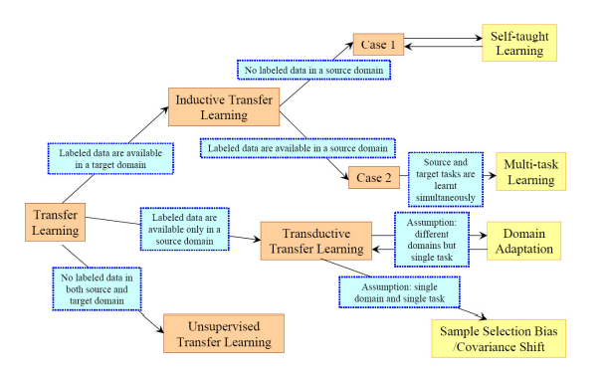
Transfer Learning Methods
https://towardsdatascience.com/a-comprehensive-hands-on-guide-to-
transfer-learning-with-real-world-applications-in-deep-learning-212bf3b2f27a

Slide 18
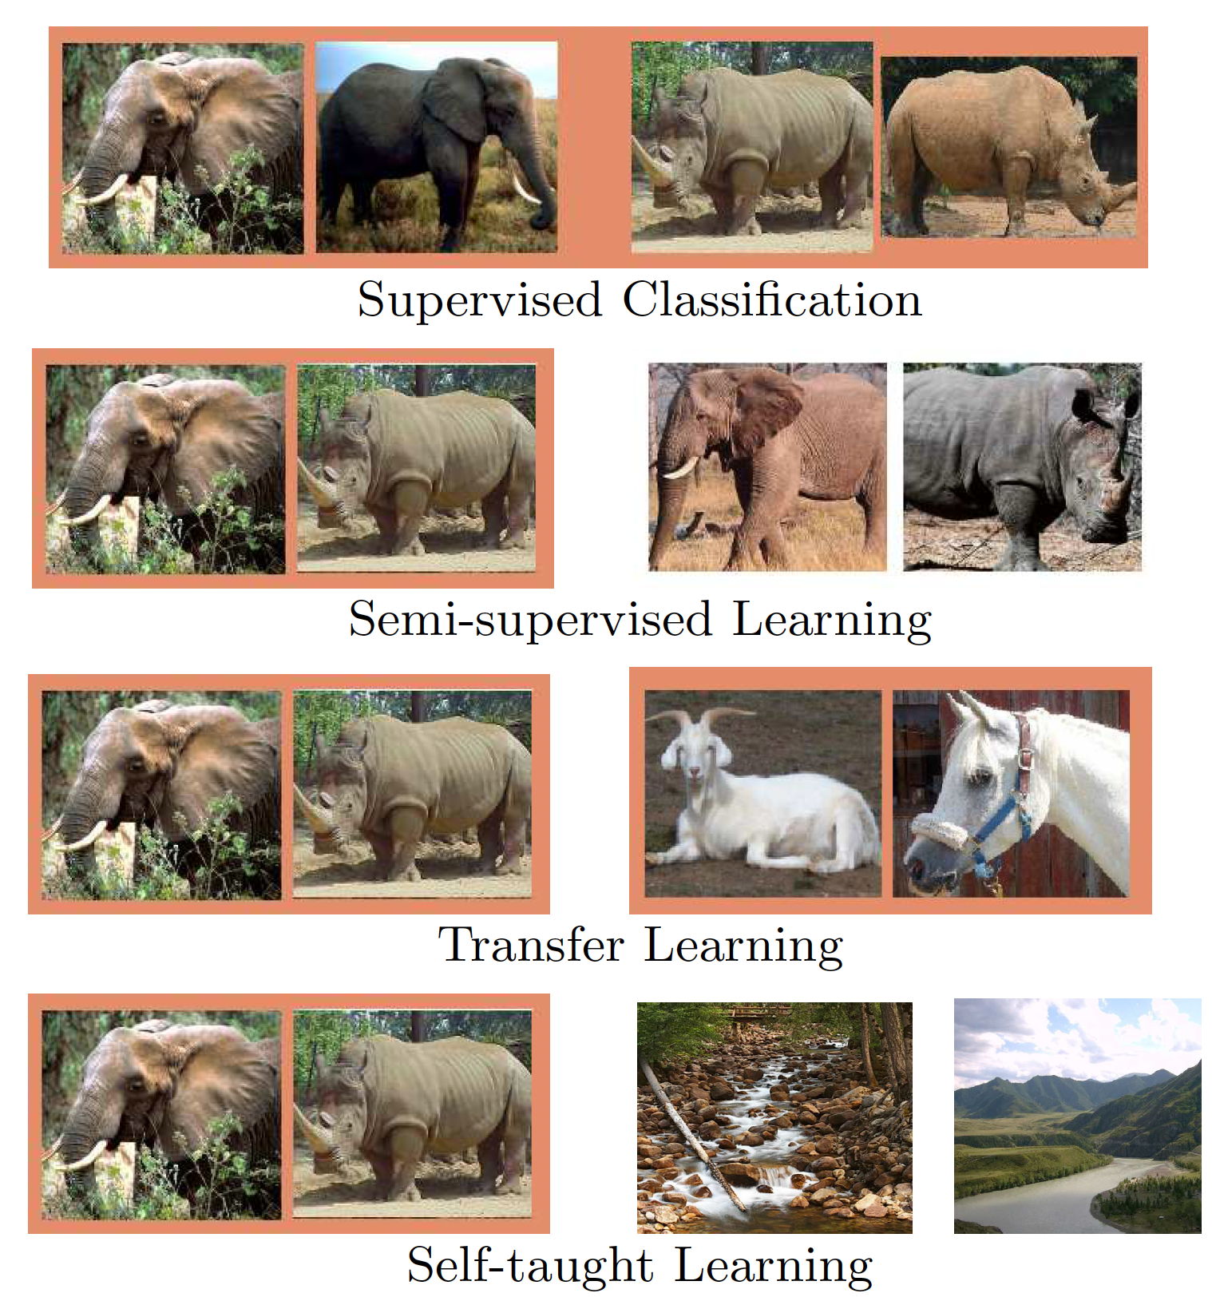
Self-Taught Learning
We assume that the number of labeled examples is small
Use patterns seen in unlabeled data to better predict class
STL is not:
Supervised classification: instead we have a lot of unlabeled examples
Semi-supervised classification: instead the unlabeled data is not in the relevant classes
Learning new classifications (a more typical example of transfer learning)
Raina et al., 2007

Slide 19
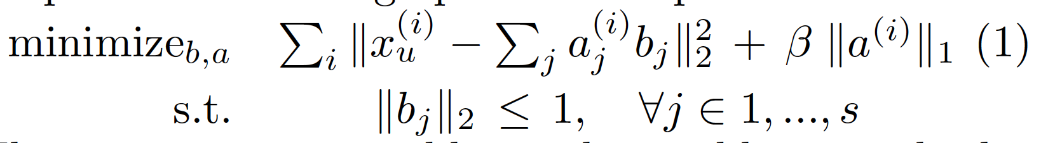
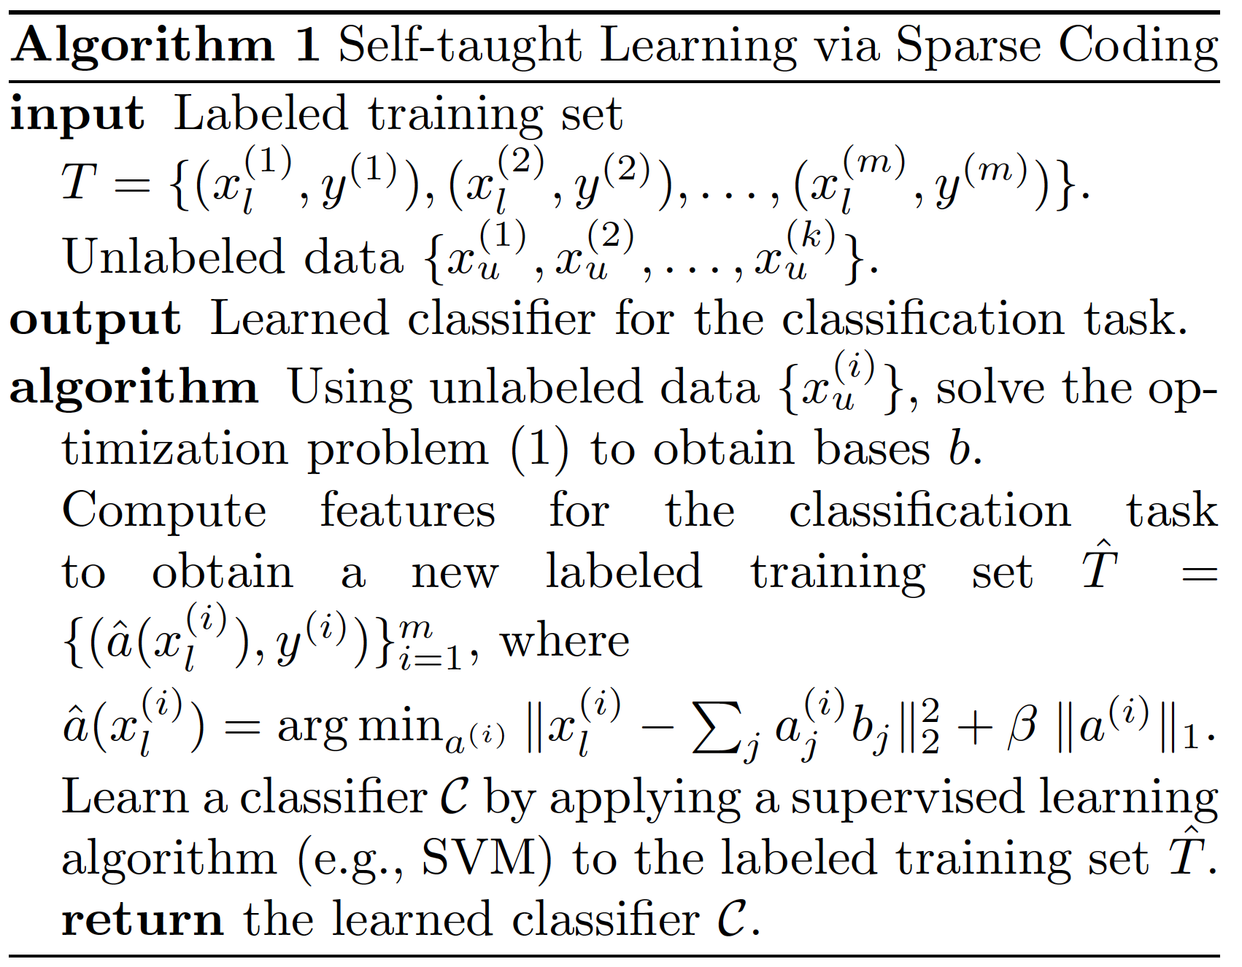
Self-Taught Learning
What do we do?
Learn higher-order structure from unlabeled data, e.g., edges in visualization
How is this useful?
If we lack labels and training data (“few shot learning”) we need a way to augment data
We can think of this as feature engineering
Neural network learns a set of basic features applicable in a wide variety of tasks
GOAL:

Slide 20
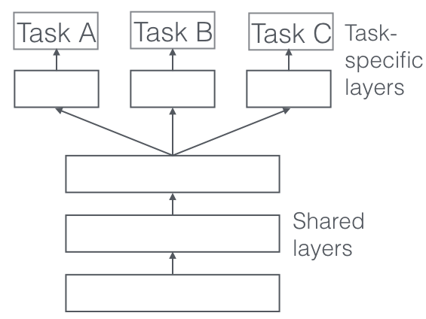
Multi-Task Learning
Important when you have “wide” data:
Multiple (possibly related) tasks (e.g., predict stress, anxiety, heart rate next day)
Small amount of data per task
Basically, we want to make the most of our data
This is very similar to “pretrained” models
https://ruder.io/multi-task/

Slide 21
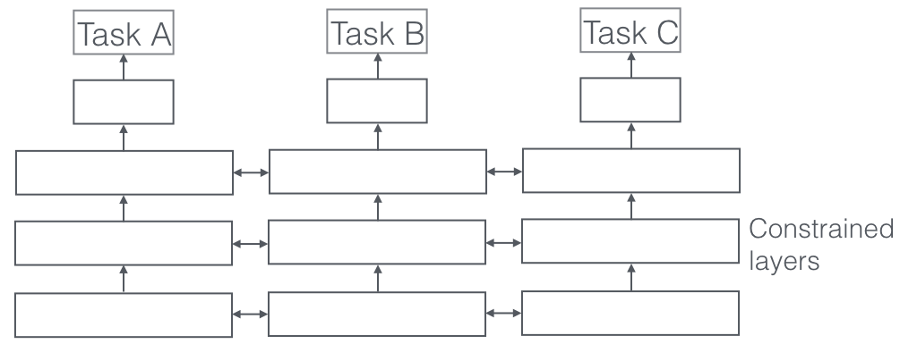
MTL: Hard versus Soft Parameter Sharing
Hard parameter sharing: good when tasks are very similar
Soft parameter sharing: may be better with less similar tasks, but knowledge gleaned is useful
“regularize” i.e., penalize if parameters are too different
https://ruder.io/multi-task/

Slide 22
Why Does MTL Work?
Implicit data augmentation
Small amount of data for each task
Sharing parameters for, e.g., 3 related tasks can provide more data for each task
Attention focusing/regularization
Noisy, high dimensional tasks risk over-fitting the data
We can avoid irrelevant features if they do not help all tasks simultaneously
Eavesdropping
Features are easy for one task, e.g., predict heartrate next day => feature that determines change in HR
…but may be hard for another (determining changes in HR can be useful to determine stress, but the task does not explicitly force the model to learn HR)
https://ruder.io/multi-task/

Slide 23
Domain Adaptation
Protected groups create different feature distributions
One issue: train mostly on one distribution but test on another distribution
Overlap is poor! Invariant solutions might perform poorly
Solution 1: domain adaptation
Make distributions similar
Solution 2: transfer learning & multi-task learning
Use model from one class to help solve other

Slide 24
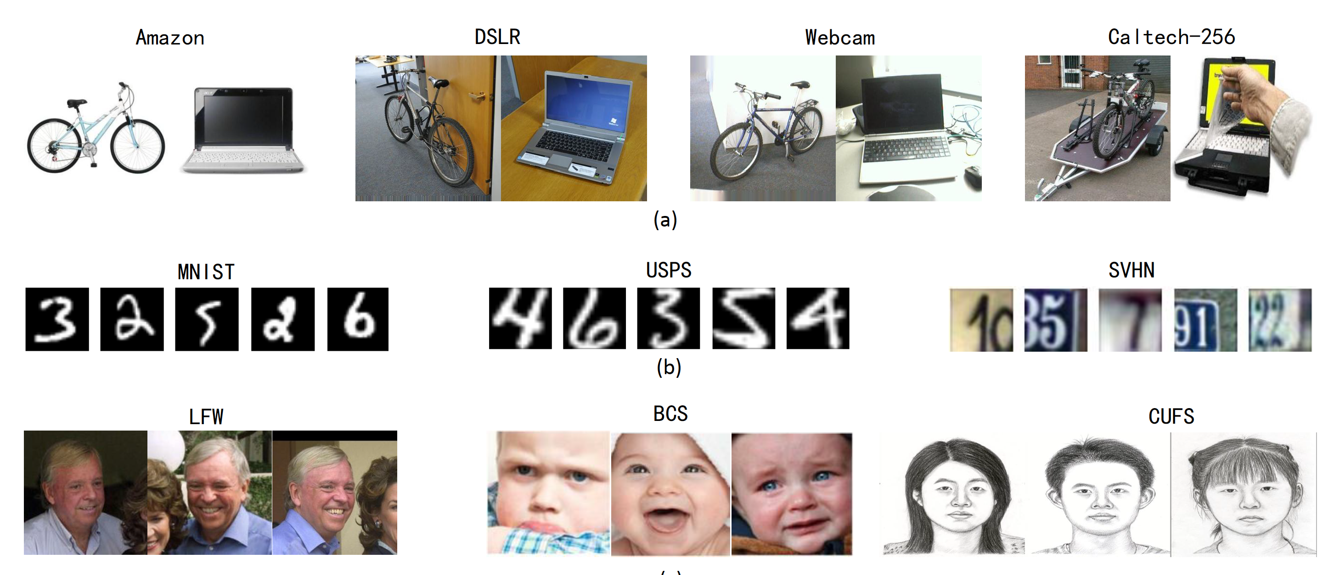
Example Use Cases
Wang and Deng, 2018

Slide 25
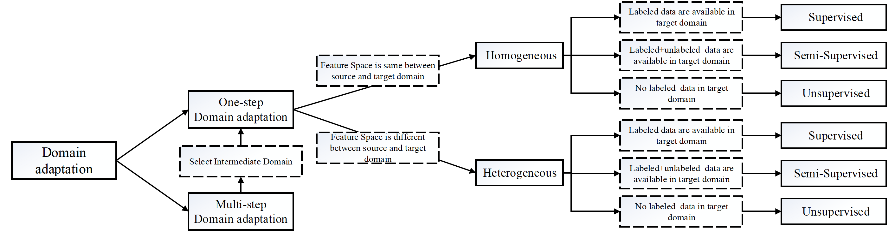
Domain Adaptation Settings
Wang and Deng, 2018

Slide 26
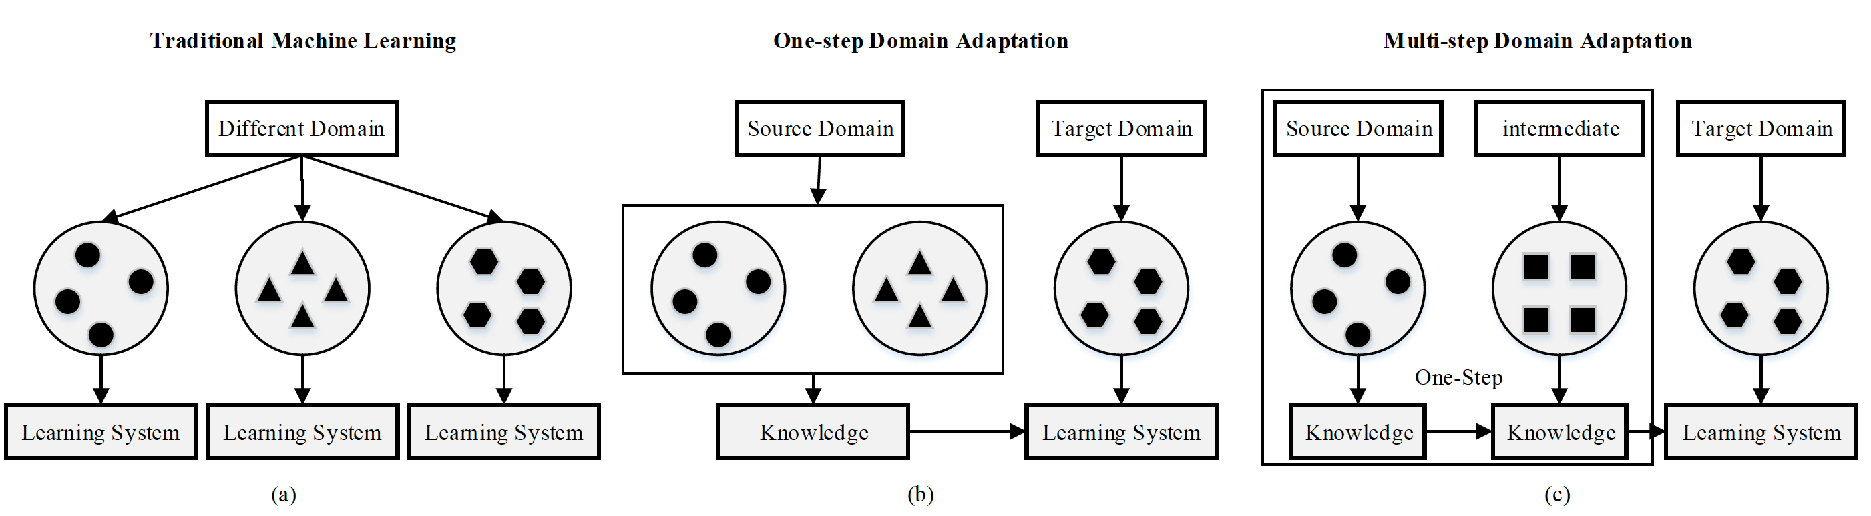
Types of DA
Wang and Deng, 2018

Slide 27
Criteria of DA
Class
Adapt target data such that labels are similar
Examples include CycleGAN or adversarial discriminative domain adaptation (ADDA)
Statistics
Adapt target data such that distributions are similar
Difficulty: what are the important statistics?
Architecture
Adjust model architecture to learn transferable features (e.g., fair AI)
Example: batch normalization (normalize batch features so model trains on similar feature distributions)
Wang and Deng, 2018

Slide 28
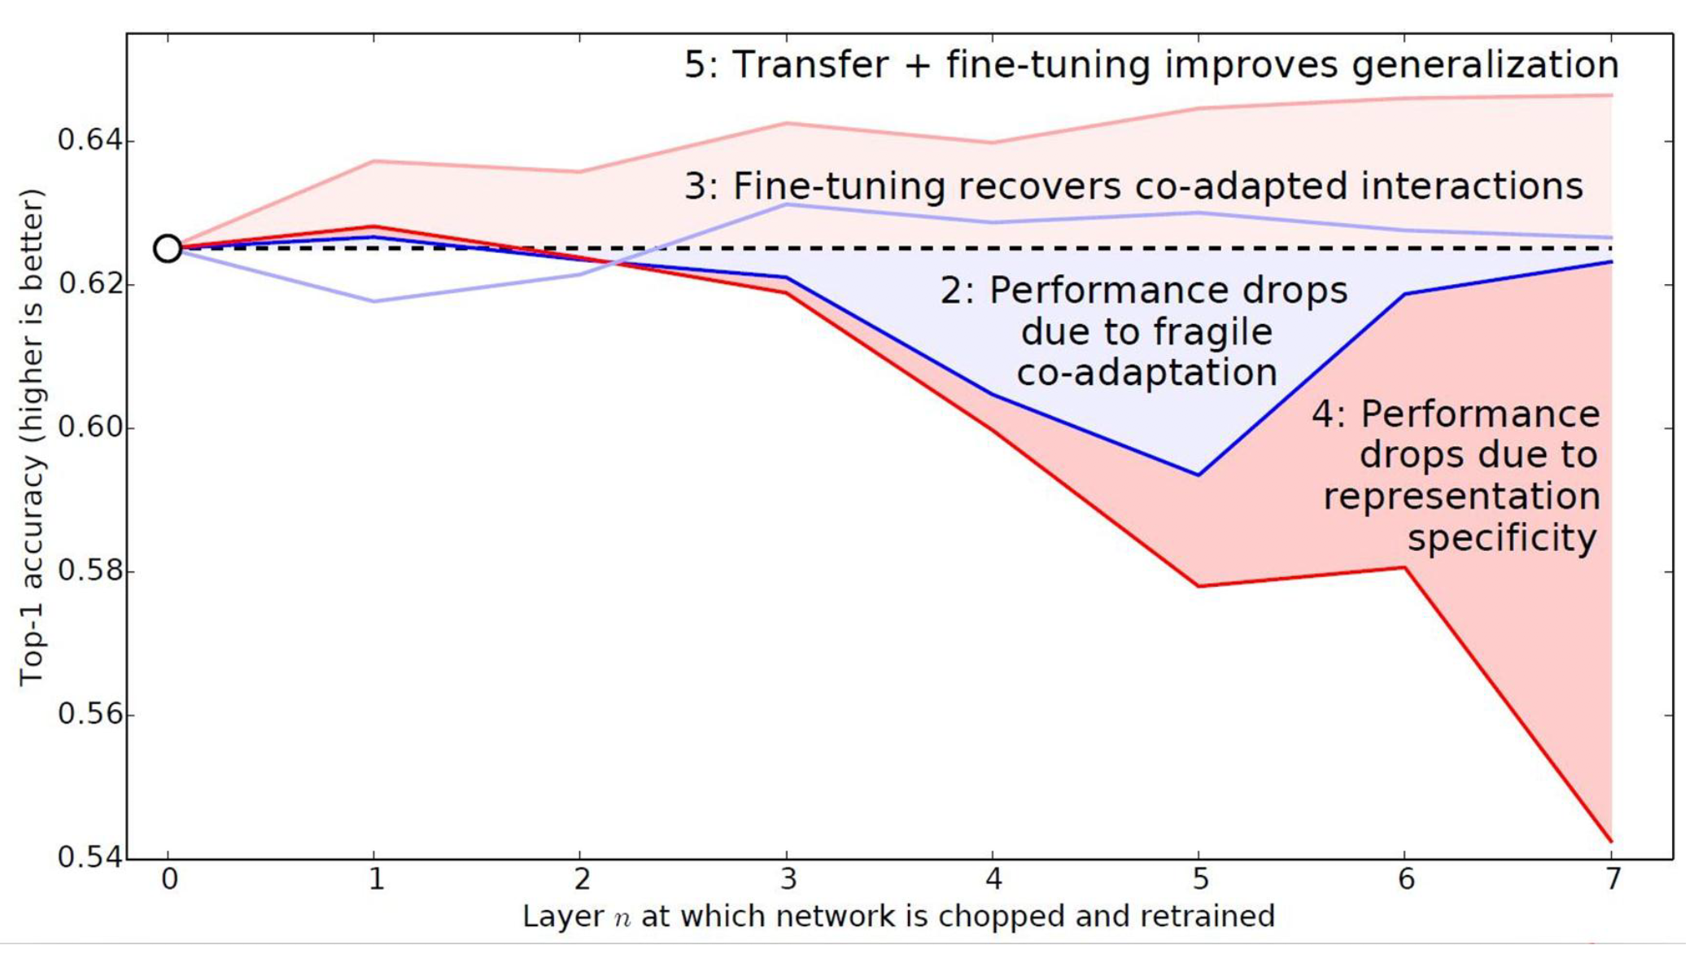
Fine-tuning
Wang and Deng, 2018

Slide 29
Fine-tuning
In general, this is the most important aspect of large models, e.g., language models, CNNs, Embeddings, etc.
They are trained to work well on a large diverse dataset
Trained to address most difficult aspects of data (broad language patterns, shapes, …)
Adding 1-2 additional layers for special dataset of interest is straight-forward, and takes advantage of all the accumulated “knowledge” of larger model
This works for any scenario with a larger models, including few-shot methods

Slide 30


Pre-trained Models
Large models like ResNet152 can very quickly recognize this is a cat
What about data it was not trained on, e.g., “gas station” vs “restaurant” (useful for self-driving cars)
Recall well-trained CNNs find edges, shapes etc.,
Use first few layers of pre-trained Deep CNN for “hard part” (finding those important shapes)
Just add additional layers (small number of additional parameters) for small dataset of interest

Slide 31
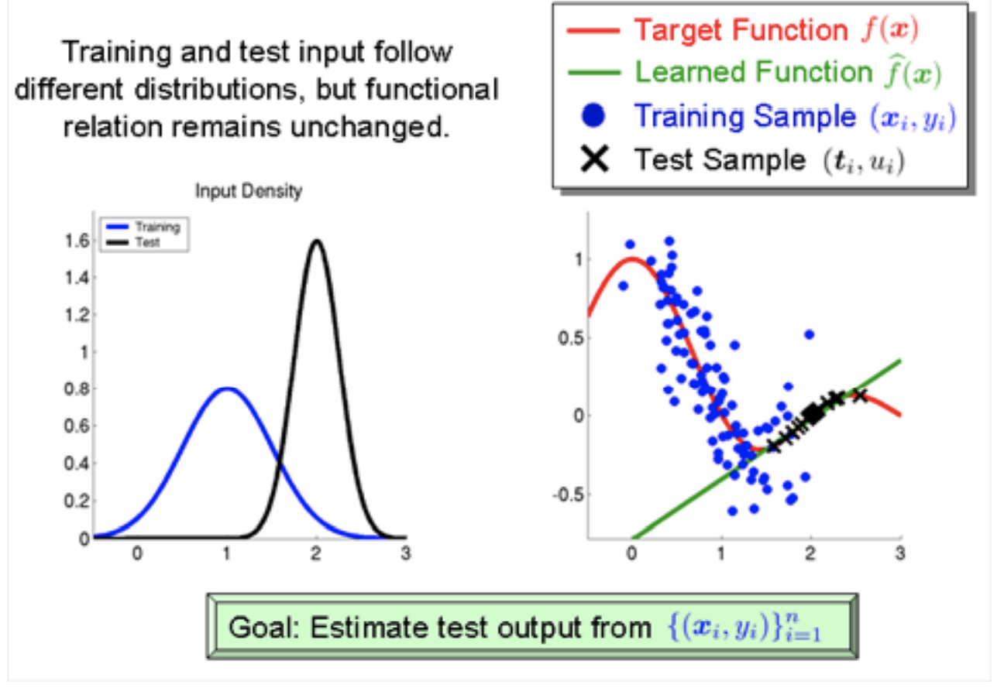
Caveat: Covariate Shift
https://towardsdatascience.com/understanding-dataset-shift-f2a5a262a766

Slide 32
Sampling Bias/Covariance Shift
We could not a priori predict a sudden change in covariates
E.g., in one set of data heart rate increases due to stress, while in another it decreases
Fundamental shifts in data imply we need a better data sample
This is partly the importance of fair AI as well: the need for diverse datasets allows us to make predictions for protected and unprotected groups
If covariance shift is expected and cannot be addressed
Fair AI solution: train model s.t. predictions do not depend on datasets
This allows for potential reduction in effect of covariate shifts

Slide 33
Changes in Priors
Could be addressed with
transfer learning between groups

Slide 34
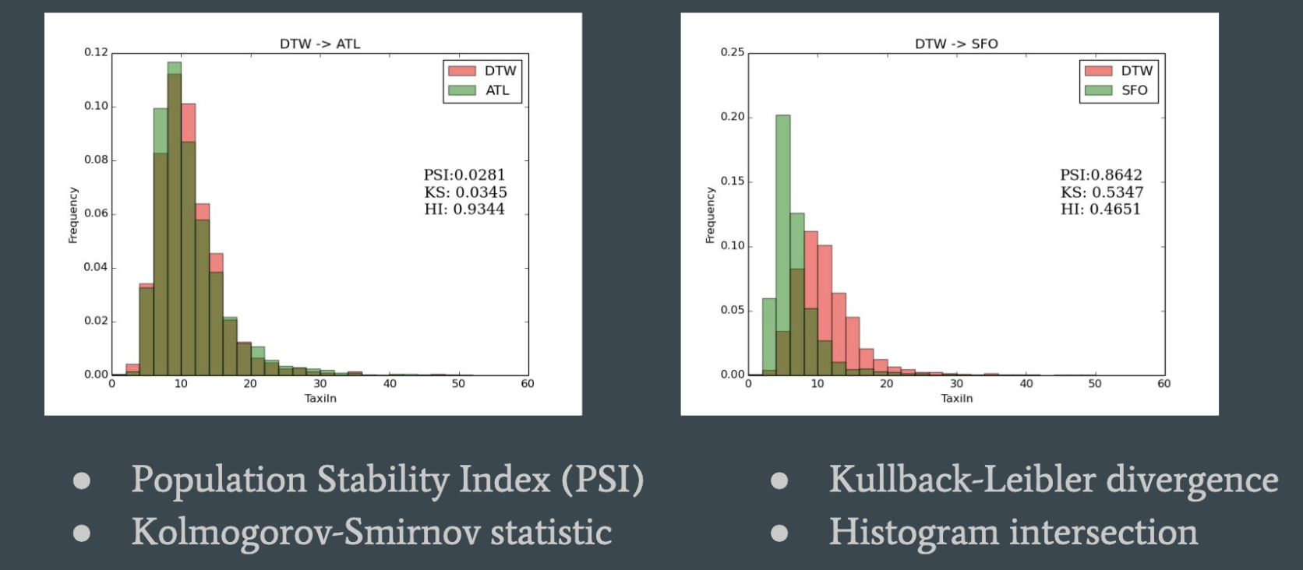
Detecting Data Shifts
Unsupervised methods:
Supervised methods include changes in accuracy – common in fairness settings
https://towardsdatascience.com/understanding-dataset-shift-f2a5a262a766

Slide 35
Zero-shot meta-learning
for small-scale data
from human subjects
Julie Jiang

Slide 36
Zero-shot predictions
Problem
Given treatment outcomes for group(s), predict outcomes for a different treatment group
Challenges
Small sample size: traditional models may overfit
Treatment outcomes for test population not known
Out-of-sample predictions: models must generalize to new populations and treatments
Individualized predictions with no training data (zero-shot)
Training group
Fine-tune/test group
Observed
Not observed

Slide 37
Meta-learning
“Learning to learn”
Finds good initialization weights for a given task/dataset
Ideal for…
Transfer learning (across similar tasks or datasets)
Zero/few-shot learning
Small datasets
Finn et al., 2017; Nichol and Shulman, 2018; Li et al, 2017

Slide 38
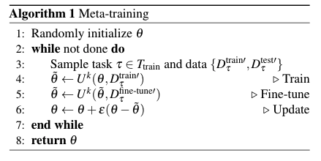
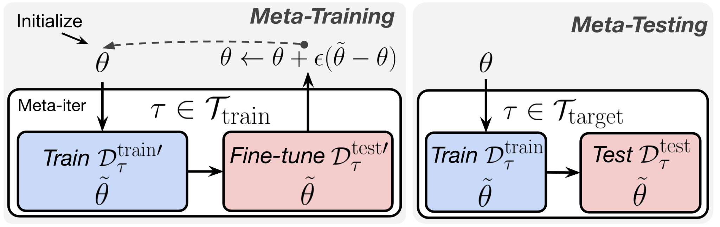
Meta Learning
Training task selection: Given test task(s): find training tasks that are related to the test tasks
Meta-training on training tasks: learns treatment group embeddings
Train on training groups
Fine-tune on test group
Meta-test on test tasks
Train on training groups
Test on test group

Slide 39
Meta-learning: training task selection
Use heuristics to choose features that are most related to the target prediction tasks
Pearson correlation
Mutual information
Manual selection with domain knowledge

Slide 40
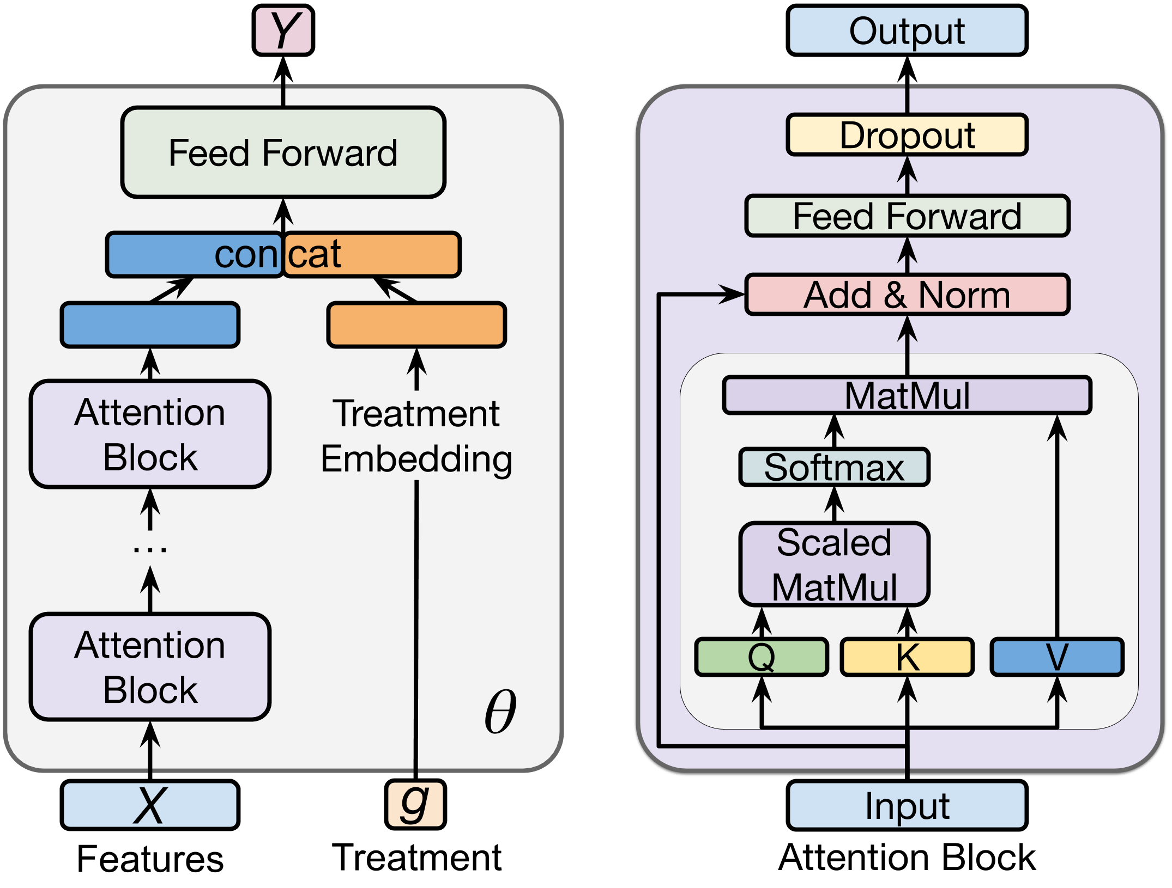
Meta-training: base-learner
Base-learner: DNN + feature embeddings
Training
Learn to predict training tasks for training groups
Learns treatment embeddings for training groups
Fine-tuning:
Fine-tuning
Learns treatment embeddings for the test group
Model quickly adapts to make predictions for the test group
Final weights goes into updating the initialization weights for the next round of training/predictions
Base learner architecture

Slide 41
Meta-testing
For every test task:
Re-initialize the model with learned weights
Train on data from the training groups
Test on data form the test group

Slide 42
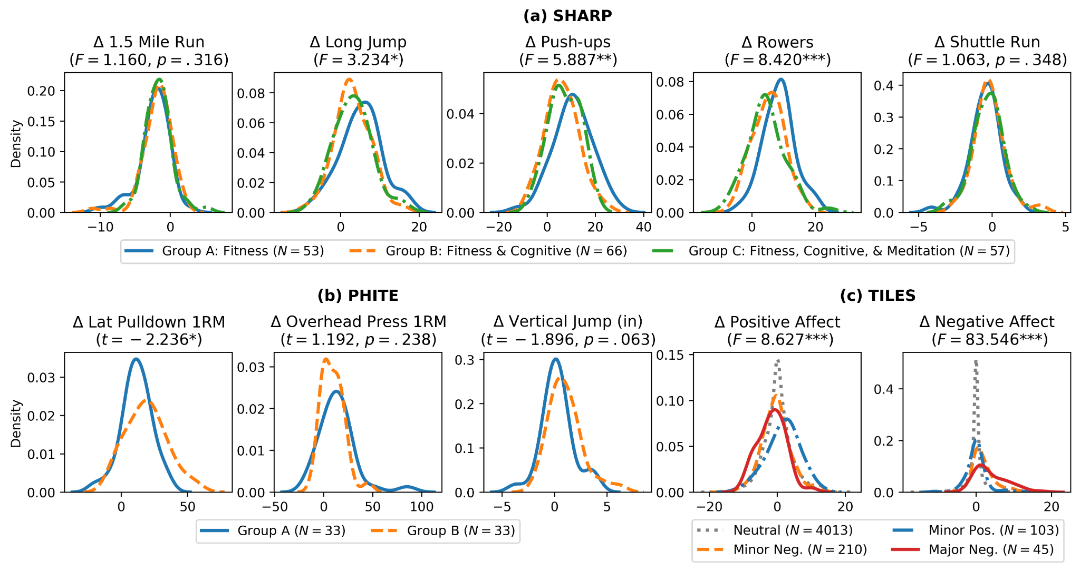
Data

Slide 43
Experiments
Regression: predict exact values for each prediction task
Binary classification: predict whether a value is greater than 0

Slide 44
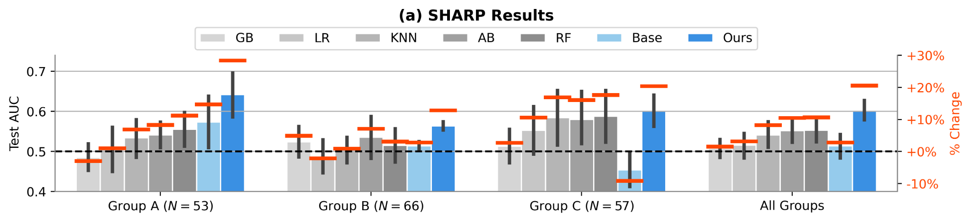
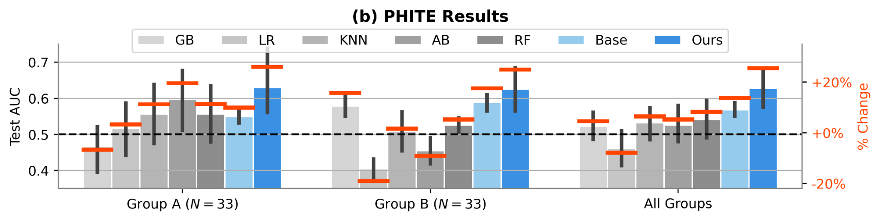
Classification Results
Biggest performance gains for test groups that have the most different distributions from the training groups
E.g. Group A for SHARP and group Major Neg. for TILES (next slide)
X-axis: test group, Left Y-axis: Test MSE; Right-Y-axis: % change from 0.50 AUC

Slide 45
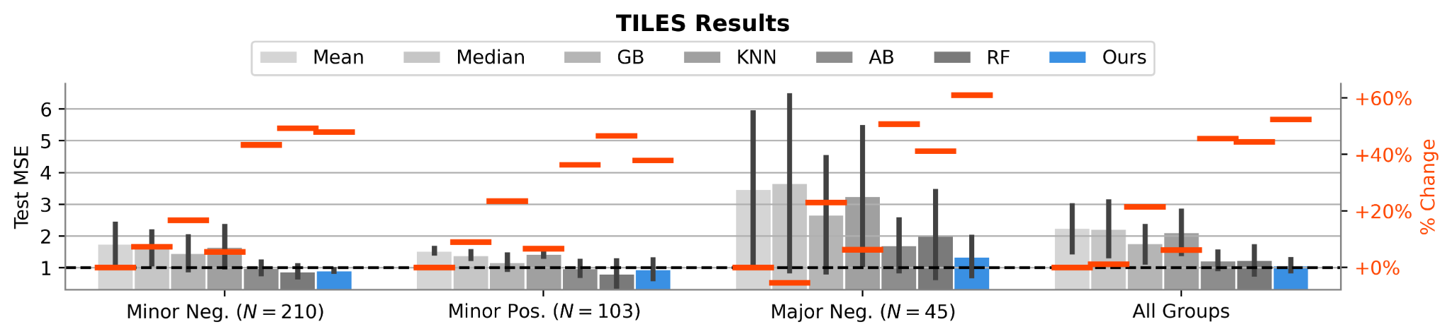
Regression Results
Biggest performance gains for test groups that have the most different distributions from the training groups
E.g. Group A for SHARP and group Major Neg. for TILES
X-axis: test group, Left Y-axis: Test MSE; Right-Y-axis: % change from the MSE using a Mean estimator

Slide 46
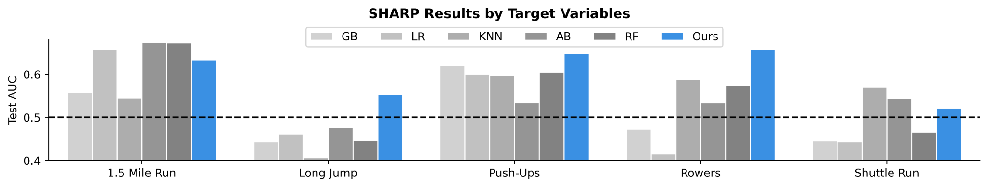
Performance gain by target task
Target tasks that have the biggest discrepancy between the training and test groups have the largest performance gain
E.g. long jump, push-ups, and rowers

Slide 47
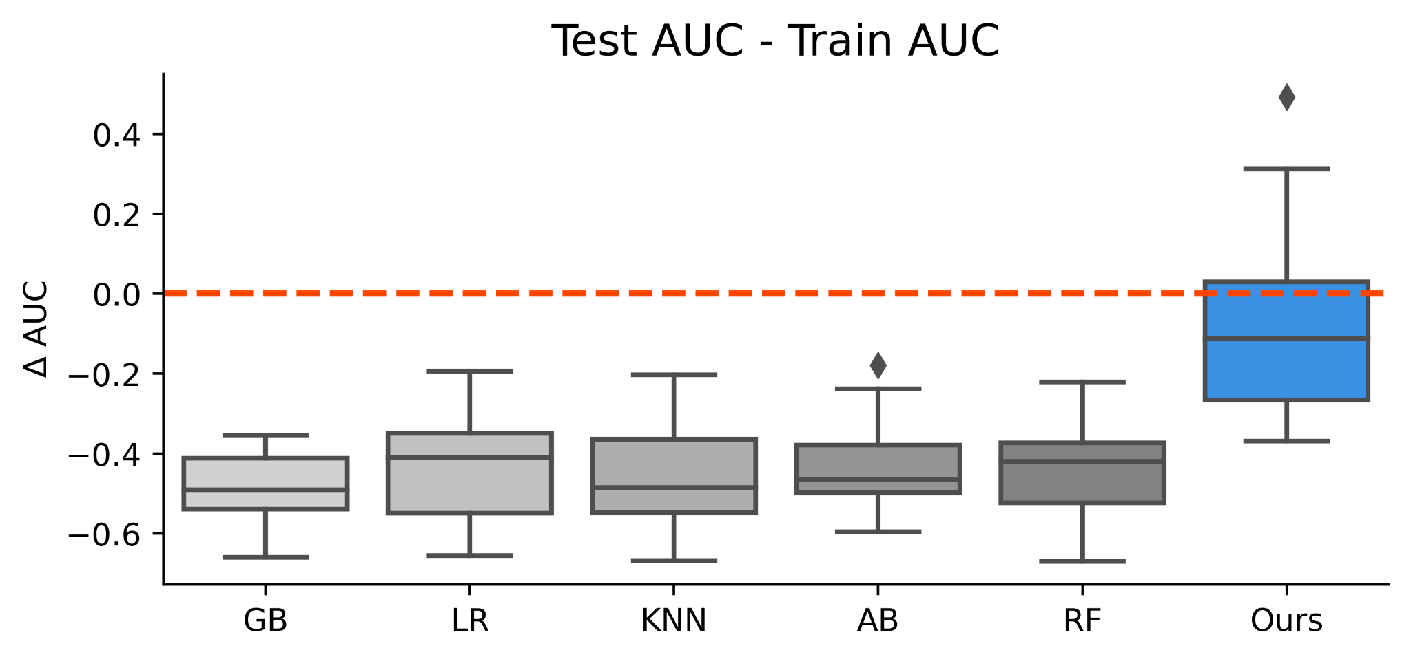
Meta-learning model avoids overfitting
Higher is better
Overfitting
Binary classification on SHARP and PHITE

Slide 48
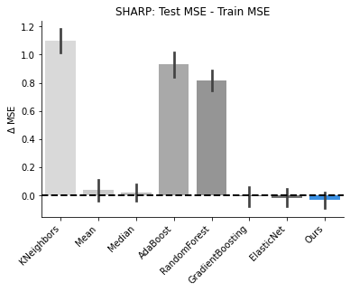
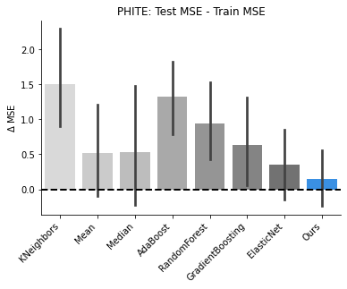
Meta-learning model avoids overfitting
Regression on SHARP and PHITE
Overfitting
Lower is better

Slide 49
Conclusion
We propose a model for zero-shot meta-learning, and we show that it applies very well to small-scale human subjects data
It is ideal when there are big discrepancies in treatment outcomes between the training and the testing subject groups
It avoids overfitting, even when the training data is very limited

Slide 50
References
Chelsea Finn, Pieter Abbeel, and Sergey Levine. Model-agnostic meta-learning for fast adaptation of deep networks. In ICML ’17, pages 1126–1135. PMLR, 2017.
Alex Nichol and John Schulman. On first-order meta-learning algorithms. arXiv preprint arXiv:1803.02999, 2018.
Zhenguo Li, Fengwei Zhou, Fei Chen, and Hang Li. Meta-SGD: Learning to learn quickly for few-shot learning. arXiv preprint arXiv:1707.09835, 2017.

